Slide 1


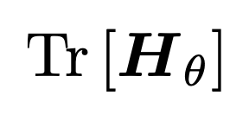
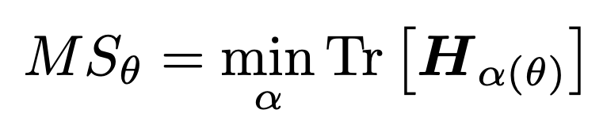

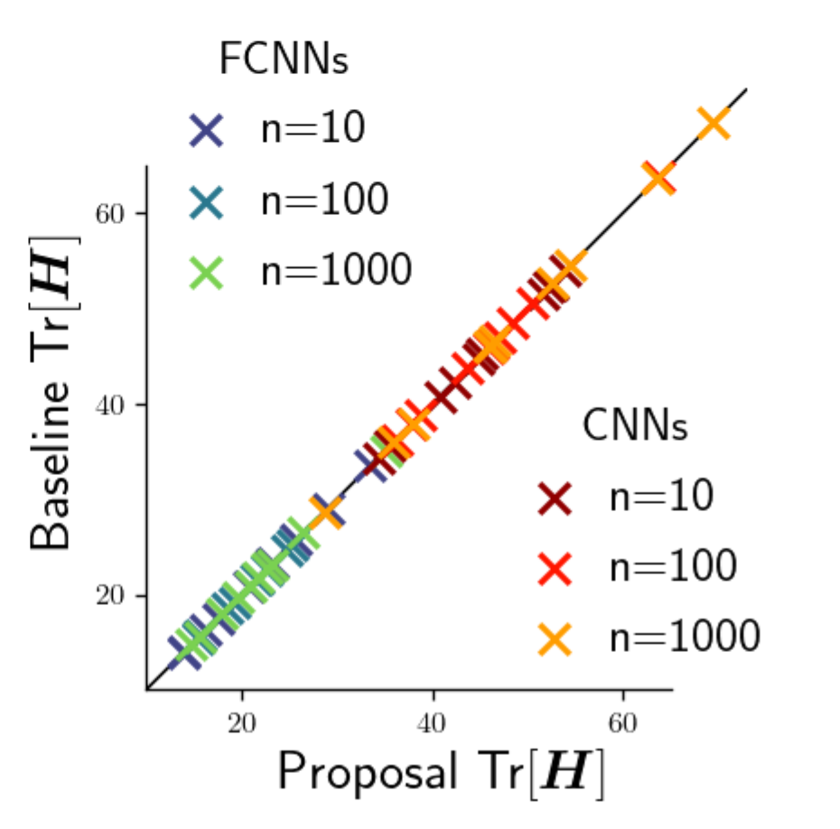
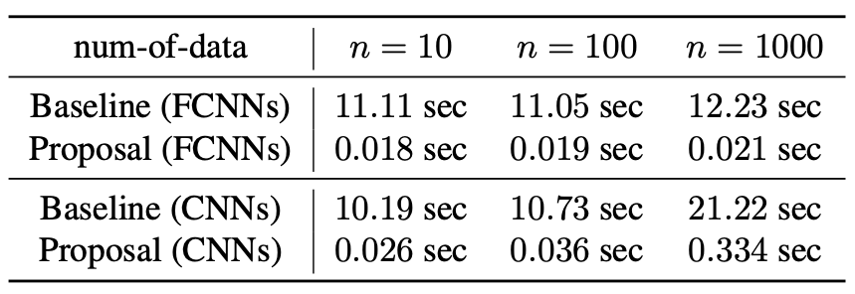
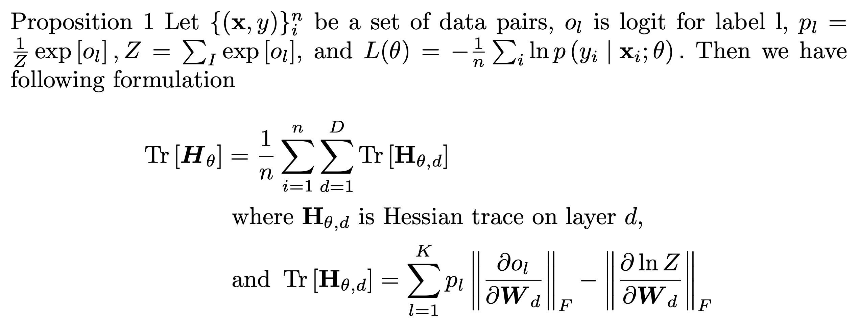
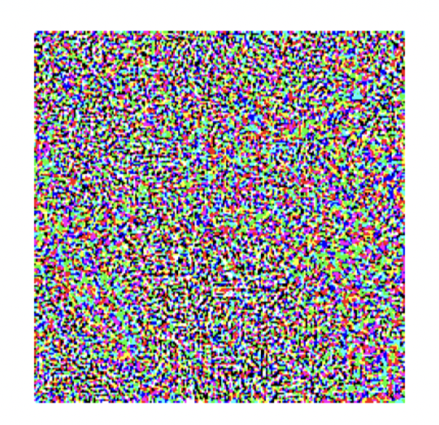
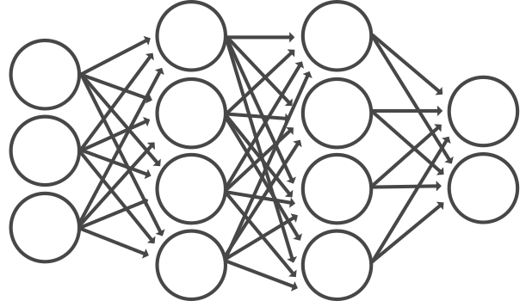
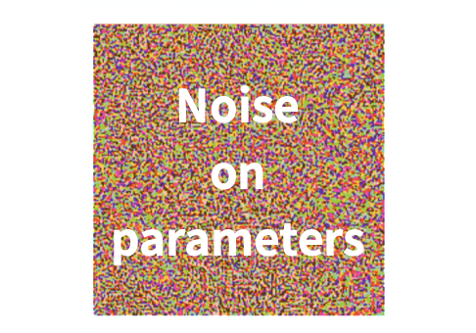
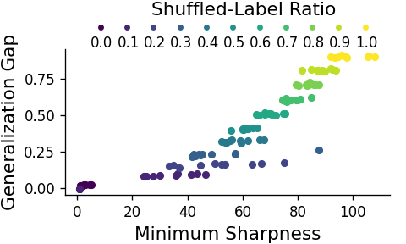
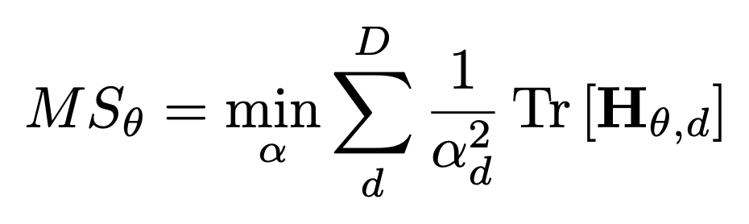
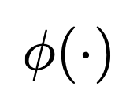
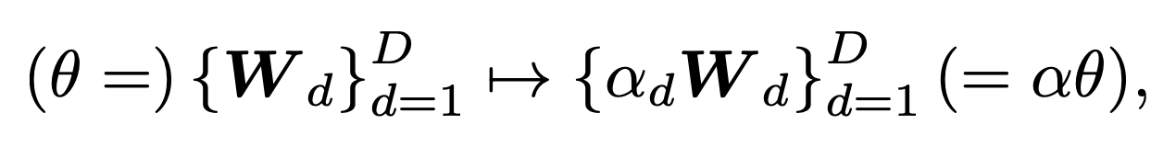
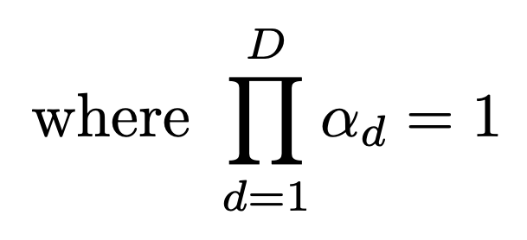
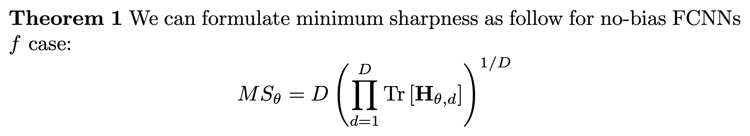
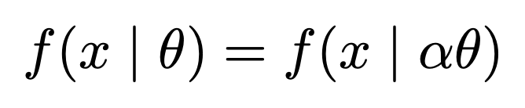
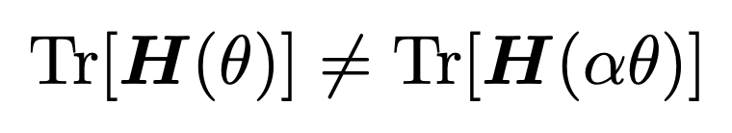


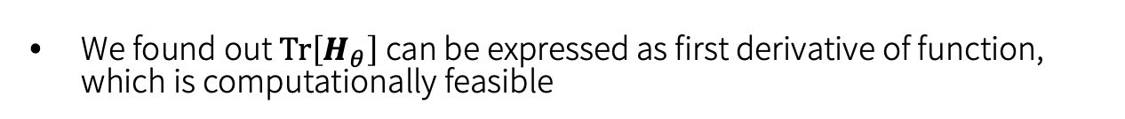

Minimum sharpness: Scale-invariant parameter-robustness of neural networks
Hikaru Ibayashi¹, Takuo Hamaguchi², Masaaki Imaizumi² ¹University of Southern California, ²University of Tokyo
Summary
Our Proposal
Experiments
Sharpness is known to have nuisance sensitivity to scale transformation
Our “Minimum Sharpness” is the first efficient scale-invariant sharpness
Efficiency, accuracy and correlation with generalization are confirmed
Definition of Minimum Sharpness
Validation of Proposition 1
We define Minimum Sharpness as a minimum value of trace of hessian over the set constituted by $α$-scale transformation
Can get exact value of (left)
Computational cost is much cheaper than naïve computation of second derivative. (right)
Background
Scale-invariant by definition
Baseline: Ground truth by computing the second order derivative
Robustness of Neural Networks
Computation of Minimum Sharpness
Against input perturbation
Noises during data collection from physical world
Active research area originated from [Goodfellow et al., 2014]
Against parameter perturbation
Noises during computation from hardware
Referred to as “sharpness”
We found out $Tr\left[H_{θ}\right]$ can be expressed as first derivative of function, which is computationally feasible
Validation of Minimum Sharpness
Noise on Input
Randomized label experiment
Trained an FCNNs with MNIST with partially randomized labels
We confirmed our minimum sharpness correlates with model performance (generalization gap)
Problem: “scale-sensitivity”
Naively defined sharpness is sensitive to a specific transformation, “$α$-scale transformation” [Dinh et al. 2017]
Thanks to proposition 1, computation of Minimum Sharpness is reduced to a convex optimization as follows
In particular, Minimum Sharpness takes a closed form on fully connected neural networks
Neural network with a non-negative homogeneous activation
$α$ - scale transformation
$α$ - scale transformation does not change functional property but does change sharpness, e.g. trace of hessian, arbitrarily
(where
has non-negative homogeneous property, such as Relu)
Resources
Paper: https://rb.gy/cnbrzg Code: https://rb.gy/881frw
Call for scale-invariant measures
Exact value is efficiently computable

